Slide 1
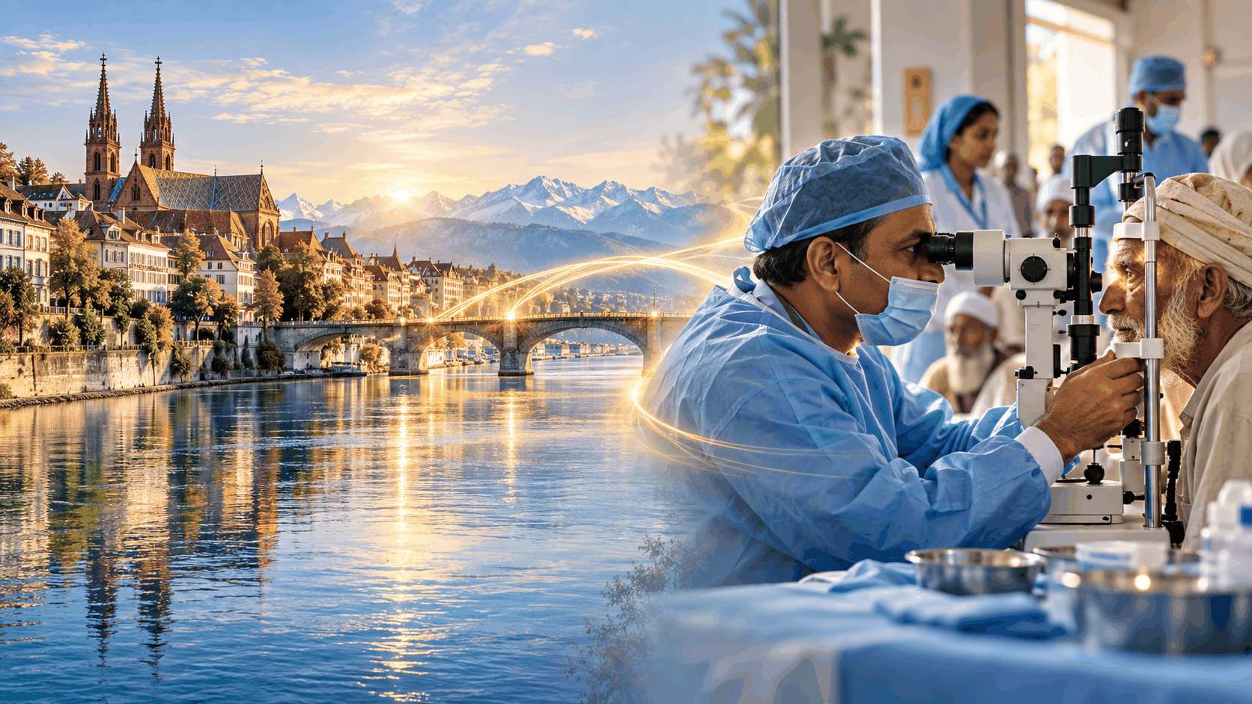
ROTARY × UDWHO • SERVICE THROUGH SIGHT
Sight Restored,
Partnership Strengthened
A gratitude and impact update for
Rotary Club Allschwil – Regio Basel
Dr. Zeeshan Ahmed Cheema
Consultant Ophthalmologist • UDWHO Pakistan
Rotary Club of Daska
28 September 2026 • Allschwil / Basel
Notes:
Opening (30–40 sec):
Good afternoon dear Rotarian friends. It is a privilege to be back with Rotary Club Allschwil–Regio Basel. Today I want to do three things: thank you, show you what your support achieved in Pakistan, and share a practical way we can continue this bridge of service between Basel and Daska.

Slide 2
A partnership that restored sight
Your CHF 2,000 contribution was converted directly into 20 free cataract operations.
CHF 2,000
20
100%
Rotary Club Allschwil – Regio Basel contribution
free cataract surgeries completed for patients in need
of the supported cohort treated through UDWHO eye-care outreach
What I value most is not only the number “20”. It is the trust behind those 20 operations — a Swiss Rotary club placing confidence in a local Pakistani team to restore vision with dignity and accountability.
Project update: supported surgeries completed in 2026.
Notes:
Key message (45 sec):
The previous support of CHF 2,000 funded 20 cataract surgeries. For me this is a very strong example of efficient Rotary service: a clear amount, a clear output and a human result. Please pause briefly after saying “20” and acknowledge the club.

Slide 3
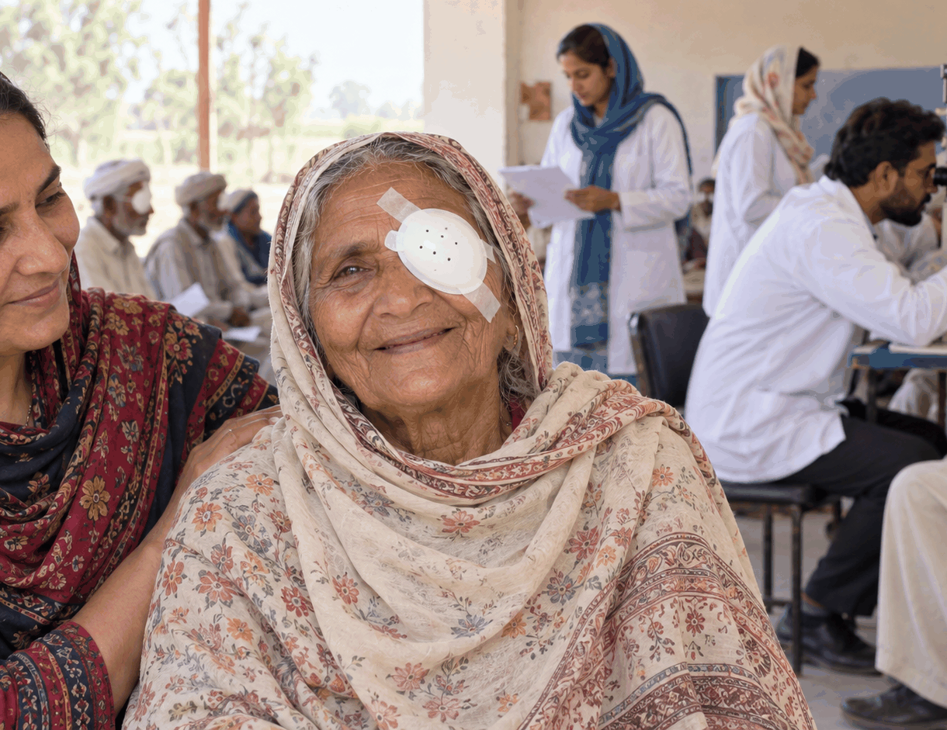
What one cataract operation can change
The clinical procedure is short; the social impact can last for years.
1
Independence
Safer mobility, reading, self-care and confidence.
2
Family relief
Less dependence on relatives for daily activities and travel.
3
Economic dignity
Vision can help a patient return to work, household tasks or community life.
“Restoring sight is not only an operation — it is often a return to participation.”
Notes:
Human impact (45 sec):
Use the image to make the project personal. Avoid claiming a specific patient story unless you have that patient’s permission. Speak generally: after cataract surgery, an older person may regain independence, reduce the burden on family members and participate again in daily life.

Slide 4
How UDWHO turns support into patient care
A simple pathway designed around access, safety and follow-up.
1
2
3
4
5
Community outreach
Screening
Counselling
Surgery
Follow-up
Identify patients in rural and underserved areas
Visual acuity, slit-lamp exam and medical assessment
Explain procedure, expectations and follow-up
Cataract operation with intraocular lens implantation
Post-operative review, medicines and outcome check
The principle is straightforward: donor confidence → organised care → measurable patient benefit.
Notes:
Process (45 sec):
Explain that UDWHO is not only paying for a surgical act. The pathway starts in the community and ends with follow-up. This is important for quality, patient trust and responsible use of donations.

Slide 5
Our wider eye-care mission
Cataract surgery is the entry point — the long-term goal is a stronger local eye-care system.
CATARACT
DIABETIC RETINOPATHY
Free surgery for patients who cannot otherwise afford treatment
Screening and referral for people at risk of avoidable retinal vision loss
RURAL OUTREACH
TRAINING
Bring screening closer to communities with transport and access barriers
Build skills among allied health staff and young eye-care professionals
Notes:
Mission (40 sec):
Position UDWHO as broader than a cataract camp. Mention four connected priorities: cataract, diabetic-retinopathy screening, rural outreach and training. This makes the project more sustainable and allows Rotary members to support in different ways.

Slide 6
Basel → Pakistan: knowledge, friendship and service
My relationship with Basel has become a practical bridge for eye care.
FEB–OCT 2025
2025
2026
TODAY
Medical Retina
fellowship / visiting scholarship
Rotary partnership
strengthened
20 cataract surgeries
completed
Share results &
shape the next chapter
University Eye Hospital Basel
Allschwil – Regio Basel
UDWHO Pakistan
Basel ↔ Daska
What began as professional learning in Basel has grown into a relationship that can move knowledge, goodwill and practical resources toward patients who need them.
Notes:
Personal bridge (45 sec):
This is where you connect your Basel fellowship with Rotary. Emphasise that your time at University Eye Hospital Basel enriched your clinical experience, while Rotary friendship created a channel to translate that learning into service in Pakistan.

Slide 7
The next chapter: a scalable monthly model
UDWHO’s working target is 100 free cataract surgeries per month.
100
20 surgeries
≈ CHF 2,000
One focused patient cohort
surgeries / month
50 surgeries
≈ CHF 5,000
A larger outreach cycle
A practical goal that can be built in sponsored cohorts rather than one large commitment.
100 surgeries
≈ CHF 10,000
One full monthly target
Illustrative planning basis: ≈ CHF 100 per cataract operation, reflecting the previous club-funded cohort.
The key is flexibility: a club, donor or small group can fund a cohort that matches its comfort level.
Notes:
Future model (60 sec):
Present this as a menu, not a demand. The earlier CHF 2,000 / 20-surgery project provides a simple planning assumption of roughly CHF 100 per surgery. Say clearly that exact costs can vary, but the cohort model makes future support transparent and scalable.

Slide 8
Collaboration does not have to mean “only money”
Four practical ways Rotary friends can strengthen the programme.
01
Sponsor a surgical cohort
Support 20, 50 or 100 cataract surgeries with clear reporting.
02
Mobilise equipment & IOLs
Connect UDWHO with safe surplus, demo or near-expiry ophthalmic resources.
03
Enable DR outreach
Back a diabetic-retinopathy screening day or referral pathway.
04
Build professional exchange
Link clinicians, trainees and institutions between Switzerland and Pakistan.
The best next step is the one that fits naturally with the club’s priorities and network.
Notes:
Collaboration options (60 sec):
This slide is important because it keeps the conversation open. Some members may know an ophthalmic company, hospital, foundation or colleague. Ask for introductions as well as direct sponsorship. Equipment and IOL support can sometimes be as valuable as cash.

Slide 9
Thank you for helping turn
friendship into restored sight.
With special gratitude to President Markus Lack, PDG Urs Herzog, and all members of Rotary Club Allschwil – Regio Basel.
Let us keep this Basel–Pakistan bridge of service open.
Dr. Zeeshan Ahmed Cheema • UDWHO Pakistan • Rotary Club of Daska
Discussion & questions
Notes:
Closing (30 sec):
Thank the president, PDG Urs Herzog and all members. Then stop speaking for a moment and invite discussion. A strong closing line is: “You have already shown what one Rotary friendship can do. I hope we can now make that impact repeatable.”

